Slide 1
Identify the Structure

Slide 2
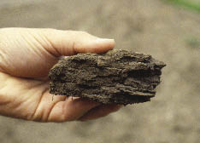

Slide 3
Platy

Slide 4
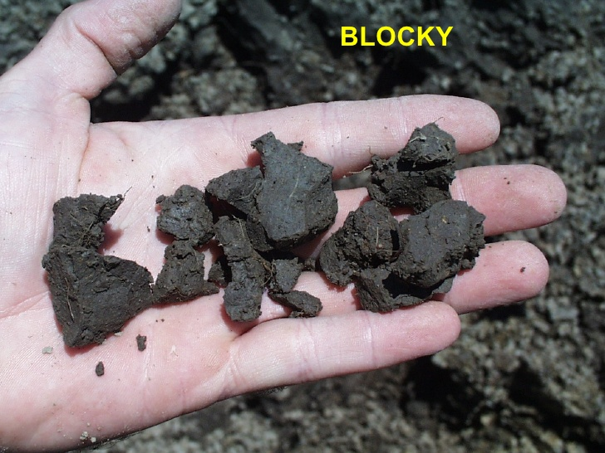

Slide 5
Blocky

Slide 6
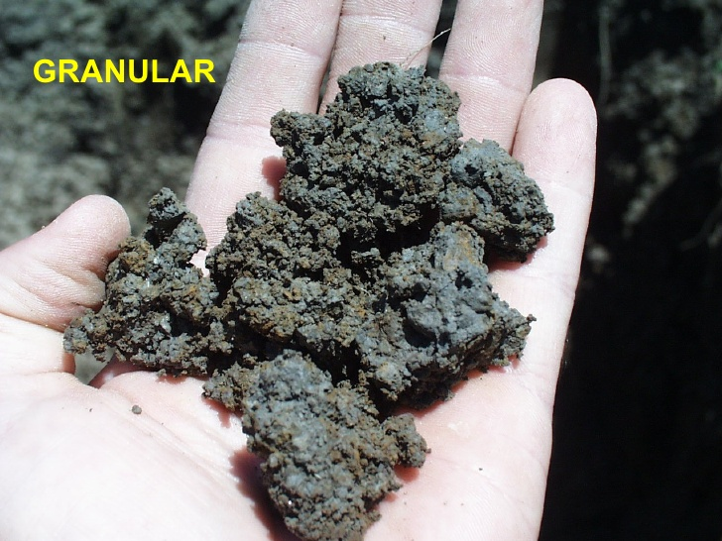

Slide 7
Granular

Slide 8
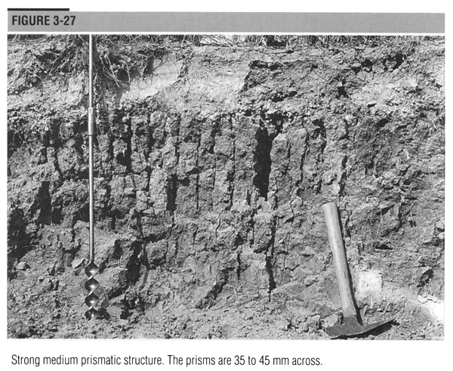

Slide 9
Prismatic

Slide 10
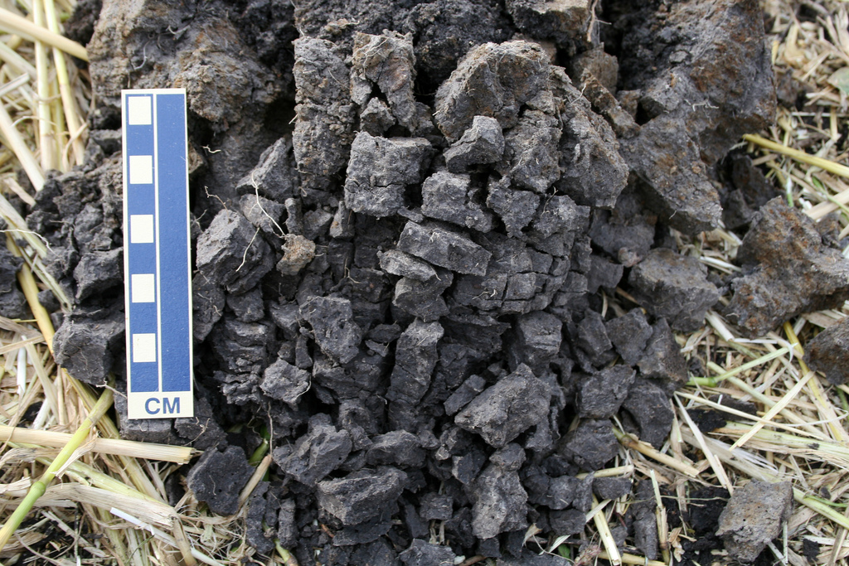

Slide 11
Blocky

Slide 12
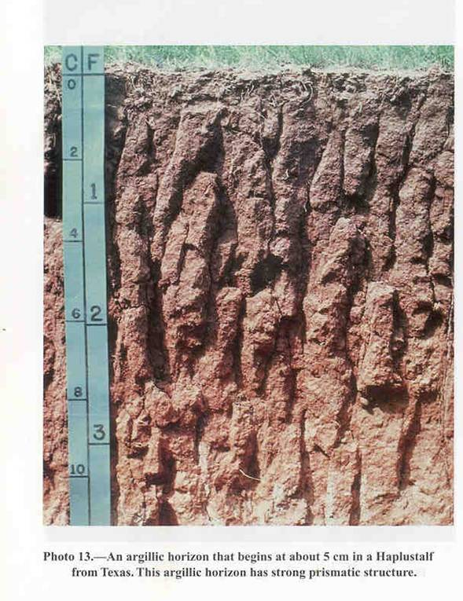

Slide 13
Prismatic

Slide 14
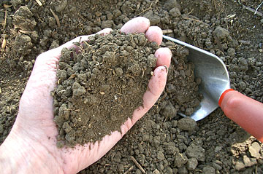

Slide 15
Granular

Slide 16
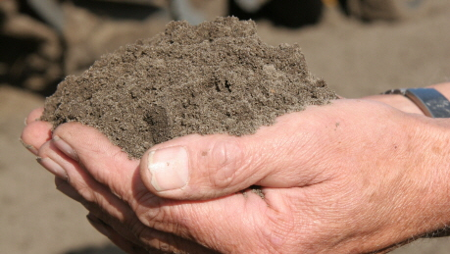

Slide 17
Single Grained

Slide 18
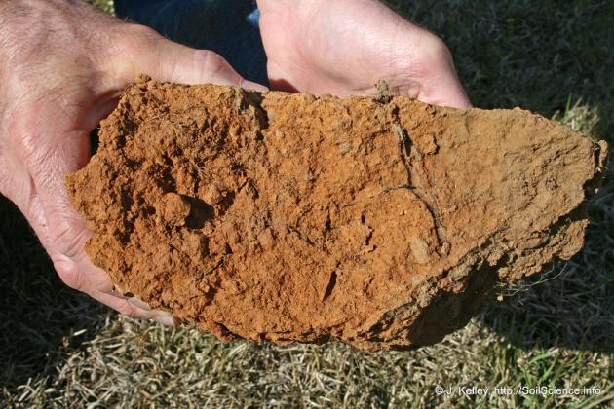

Slide 19
Massive

Slide 20
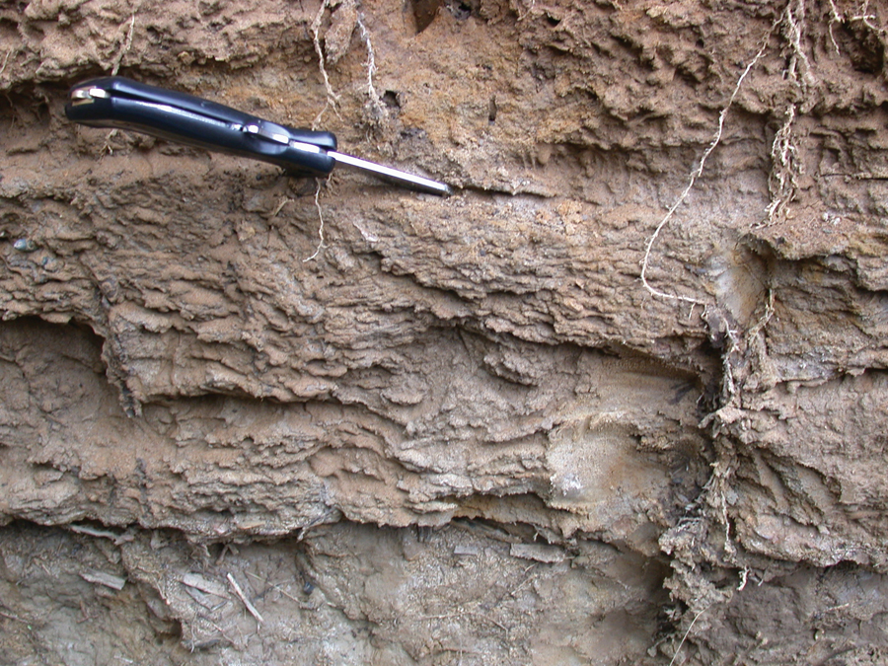

Slide 21
Platy

